Slide 1
Tutorial 5
Digital Electronic Circuits

Slide 2
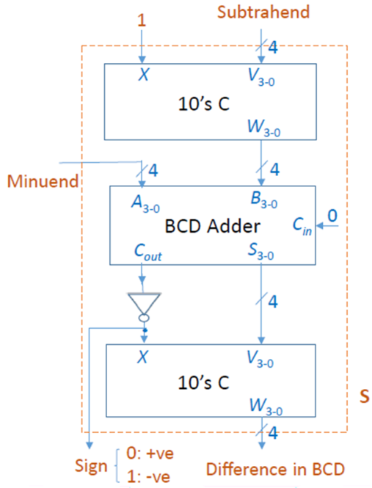
Time limit: 10 mins
Q.1 a)
Consider the given BCD subtractor unit to compute the subtraction (27.25)₁₀ - (38.26)₁₀ and mention the result of each block.
b)
Determine the number of BCD correction required in the BCD addition of: (646)₁₀ + (354)₁₀

Slide 3
Time limit: 10 mins
Q.2 a)
Provided the carry generate and carry propagate as G_{i}=A_{i}B_{i} and P_{i}=A_{i}+B_{i} respectively, show that
1) C_{i+1} = (C_{i}’G_{i}’+P_{i}’)’
2) S_{i} = (P_{i}G_{i}’)⊕C_{i}
b)
A 1 bit Full Adder circuit takes 75 ns to produce the sum and 60 ns to produce the carry. If a 4 bit parallel adder is to be designed with the Full Adder block, What will be the minimum propagation delay for getting the results? Maximum how many 4 bit addition per second can be expected from this design?

Slide 4
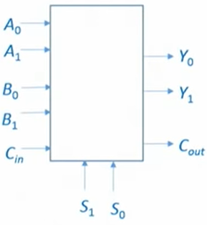
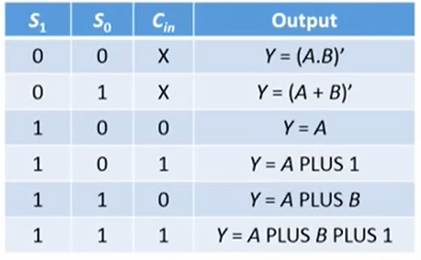
Time limit: 15 mins
Q.3
Consider the following 2-bit ALU with the given truth table. Find out the minimized expression for output Y1 when input Cin =1. (The output expressions in truth table are valid for both Y0 and Y1 independently, e.g., with S1 and S0 as 00, output Y0=(A0.B0)’ and Y1 = (A1.B1)’).

Slide 5
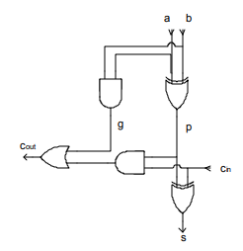
Time limit: 15 mins
Q.4. a)
In an n bit comparator circuit with n bits inputs A and B, what are the number of combinations for which A<B?
Find the number of combinations for which A<B.
b)
Q.5.
Consider the gate-level implementation of full adder (FA) as shown. Let the propagation delays of the AND, OR and XOR gate is tp, tq and tr respectively. The worst case delay of the sum output of the n-bit ripple carry adder comprising the FA blocks below is?

Slide 6
Q.1. a) Consider the given BCD subtractor unit to compute the subtraction (27.25)₁₀ - (38.26)₁₀ and mention the result of each block
A.1. a) (27.25)₁₀ - (38.26)₁₀
Minuend = (27.25)₁₀
Subtrahend = (38.26)₁₀
10’s complement of (38.26)₁₀ = (61.74)₁₀
BCD adder= A (0010 0111 .0010 0101) + 10’s C of B (0110 0001. 0111 0100)
= 0 1000 1000.1001 1001 = (88.99)₁₀
10’s complement of BCD adder output = -11.01 (sign negative as X=1)

Slide 7
Q.1. b) Determine the number of BCD correction required in the BCD addition of: (646)₁₀ + (354)₁₀
A.1. b) (646)₁₀ = 0110 0100 0110
(354)₁₀ = + 0011 0101 0100
--------------------------------
1001 1001 1010
+ 0110
----------------------------------
1001 1010 0000
+ 0110 0000
-----------------------------------------
1010 0000 0000
+ 0110 0000 0000
---------------------------------------
(000)1 0000 0000 0000 =(1000)₁₀
So, 3 BCD corrections are required for the given BCD addition.

Slide 8
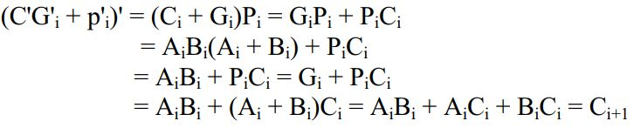

Q.2. a) Provided the carry generate and carry propagate as G_{i}=A_{i}B_{i} and P_{i}=A_{i}+B_{i} respectively, show that
1) C_{i+1} = (C_{i}’G_{i}’+P_{i}’)’
2) S_{i} = (P_{i}G_{i}’)⊕C_{i}
A.2. a) 1.
2.

Slide 9
Q.2. b) A 1 bit Full Adder circuit takes 75 ns to produce the sum and 60 ns to produce the carry. If a 4 bit parallel adder is to be designed with the Full Adder block, What will be the minimum propagation delay for getting the results? Maximum how many 4 bit addition per second can be expected from this design?
A.2. b) For n bit binary number addition, the minimum propagation delay will take place to get the sum output at the MSB position (provided sum generation takes more time than carry generation).
Propagation delay (minimum) = sum generation delay + (n-1)* carry generation delay
=75+3*60
=255 ns
So, for each second roughly 1/255ns = 3.92 * 10⁶ 4-bit addition can take place.

Slide 10
Q.3. Consider the following 2-bit ALU with the given truth table. Find out the minimized expression for output Y1 when input Cin =1. (The output expressions in truth table are valid for both Y0 and Y1 independently, e.g., with S1 and S0 as 00, output Y0=(A0.B0)’ and Y1 = (A1.B1)’).
A.3. We need to find the expression of Y1 for Cin = 1. From the truth table, we can draw the following k-map,
 | A1’B1’ | A1’B1 | A1B1 | A1B1’
S1’S0’ | 1 | 1 | 0 | 1
S1’S0 | 1 | 0 | 0 | 0
S1S0 | 1 | 0 | 1 | 0
S1S0’ | 1 | 1 | 0 | 0
Y1= A1’B1’+S0’A1’+S1’S0’B1’+S1S0A1B1
K-map for Y1 with Cin =1

Slide 11


Q.4.
a) In an n bit comparator circuit with n bits inputs A and B, what are the number of combinations for which A<B?
b) Find the number of combinations for which A<B.
A.4.Total number of combinations possible are,
Now, the number of combinations for which input bits are equal is 2^{n}.
Due to symmetry, number of combinations for A>B will be equal to the number of combinations for A<B.
Therefore, we have, combinations for A>B = A<B =

Slide 12
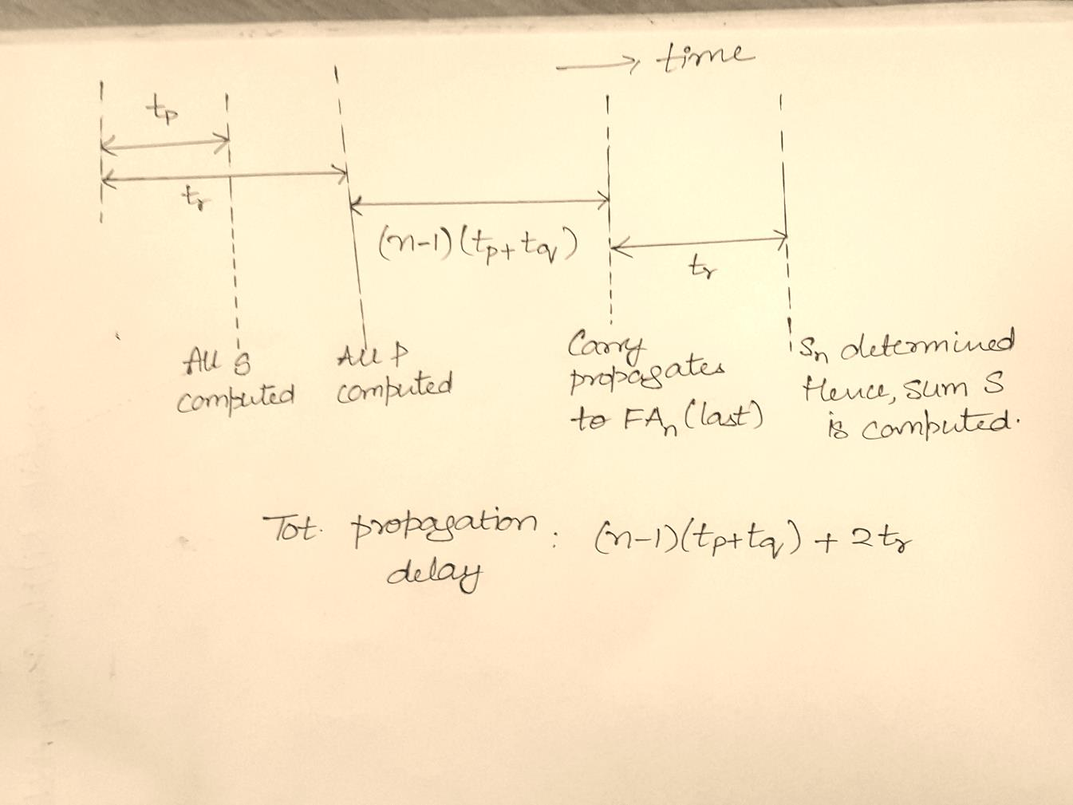
Q.5.
Consider the gate-level implementation of full adder (FA) as shown. Let the propagation delays of the AND, OR and XOR gate is tp, tq and tr respectively. The worst case delay of the sum output of the n-bit ripple carry adder comprising the FA blocks below is?
A.5.

